Slide 1
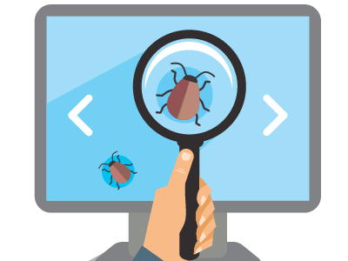
QA Fundamentals
Introduction to Software Development
SoftUni Team
Technical Trainers
Software University
http://softuni.bg

Slide 2
Table of Contents
What is a Software?
Software Distribution Types
Bugs and Why Do They Occur?
What is Testing?
QA Responsibilities
Testing Process

Slide 3
Have a Question?
sli.do
#fund-common

Slide 4

Software Development

Slide 5


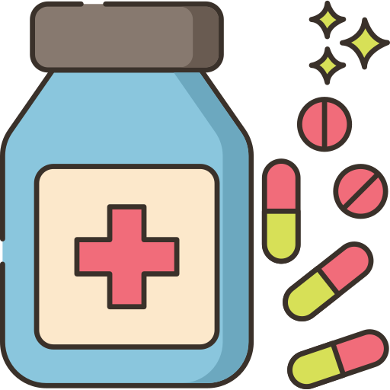
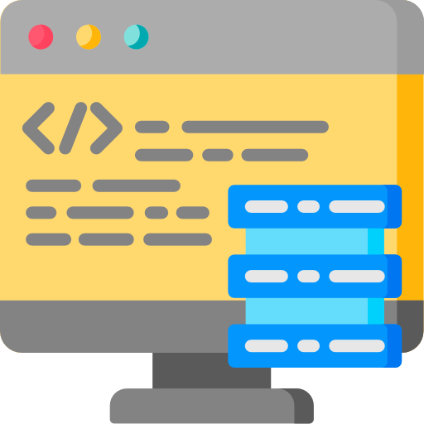

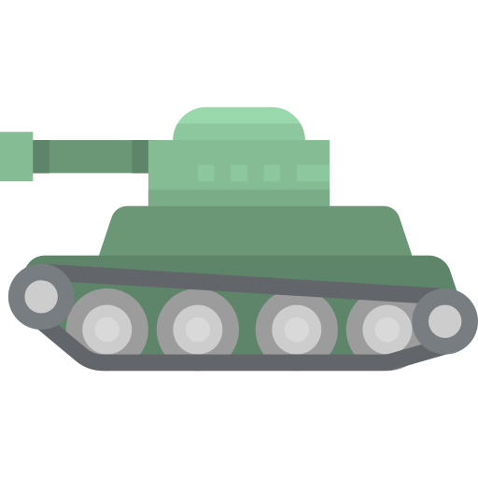

First Look at Software
Education
Business
Medicine
Military
Industry
Entertainment

Slide 6
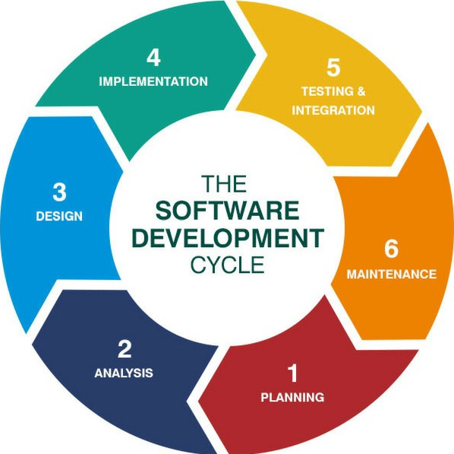
First Look at Software
Developed for 8 decades
Evolved into a profession
Concerned into quality
Software engineering
Systematical approach to software development
Phases: planning, analysis, design, implementation, testing, maintenance

Slide 7
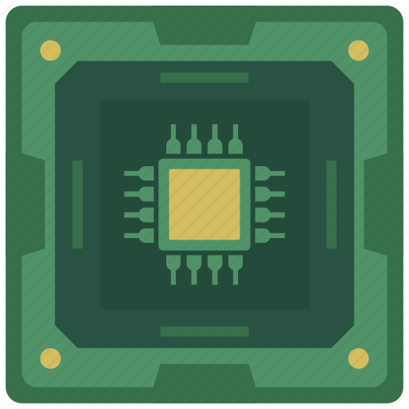
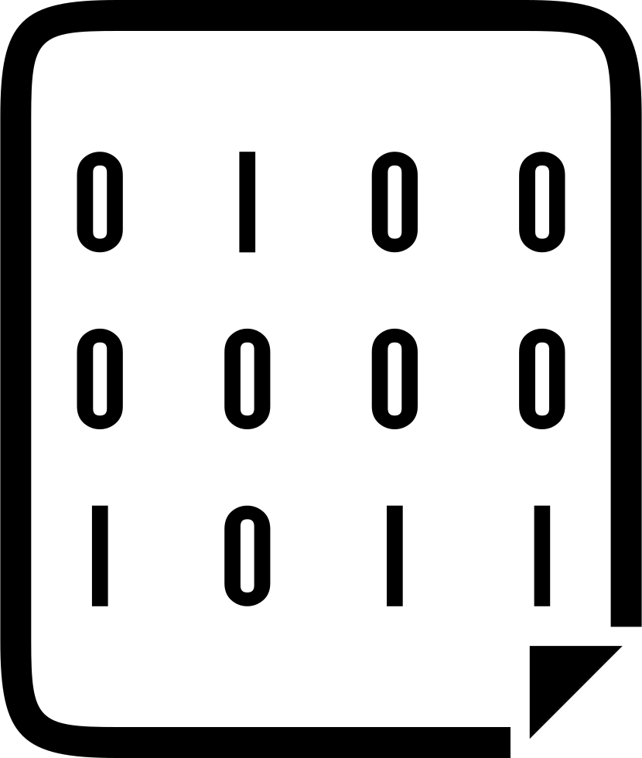
First Look at Software
Definition: software is a set of machine-readable instructions that directs a computer's processor to perform specific operations

Slide 8
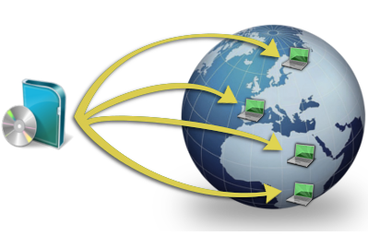
Types of Software
Software Distribution

Slide 9

Retail Software
Retail software – installable desktop packages
The majority of software until the emergence of Internet

Slide 10

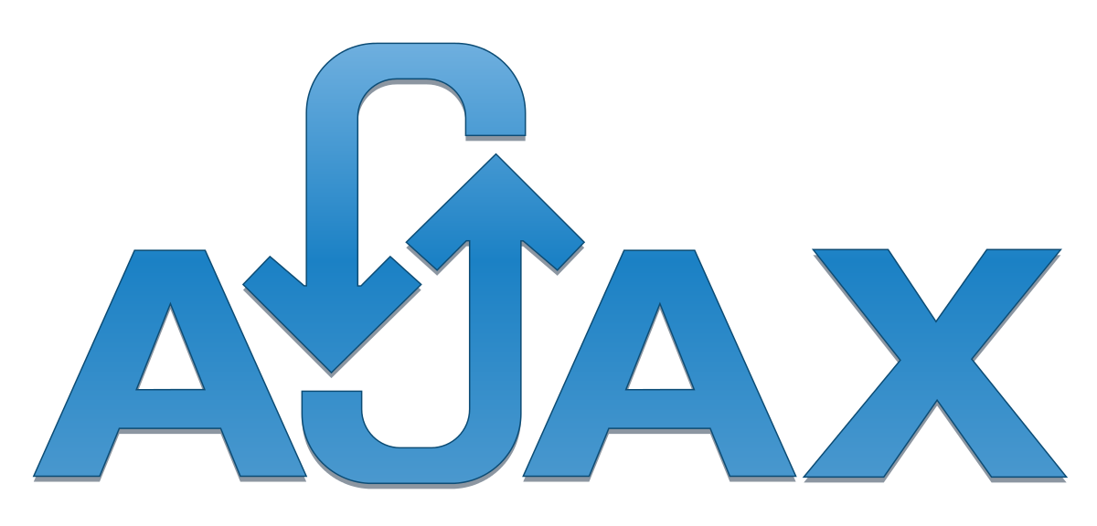
Web Applications
The concept has been introduced in 1999 in Java Servlets
A major leap in the software distribution
Browsers and technologies are developed in favor of web apps
2005 – the term AJAX was coined
2011 – HTML5 was finalized and "modern Web" emerged
Cloud apps – Web apps on the cloud

Slide 11

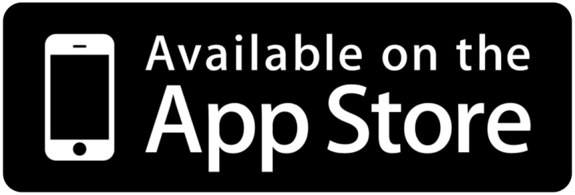
Mobile Applications
App distribution platforms began appearing in 2008
Apple app store
Google play
Windows phone store
Started as productivity and information retrieval apps
Reached bigger market share than retail software

Slide 12

Bugs

Slide 13
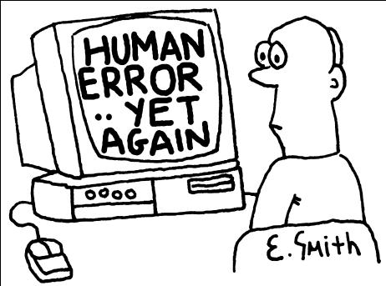
Software Defects
Human being can make an error (mistake)
Errors produce defects
Defects are faults / bugs in the program code, or in a document
If a defect in code is executed, that might cause a failure:
Fail to do what it should do
Do something it shouldn’t

Slide 14
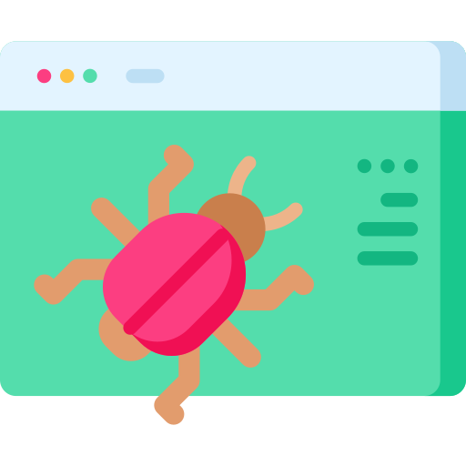
Software Defects
The human factor:
Humans make mistakes
Poor training
Time pressure
Code complexity
Complexity of infrastructure
Changing technologies

Slide 15
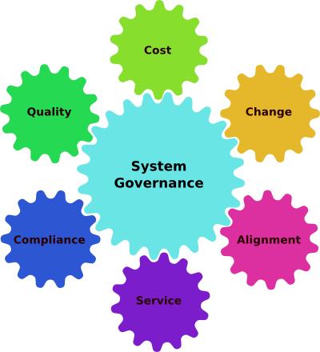
Software Defects
Organizational factors
Inefficient communication
Unclearly defined requirements
Environmental conditions
Radiation, Magnetism, Electronic fields, Pollution, Etc.
These can change the hardware conditions

Slide 16


Software Defects
Anomaly
Error
Bug
Defect
Fault
Problem
Failure
Defect / fault masking

Slide 17

Bug Fixing Importance
Unfixed bugs camouflage other bugs
Suggest quality isn’t important
Duplicate effort
Unreliable metrics and money loss
Fixing a bug today costs less than tomorrow

Slide 18

Quality Assurance (QA)
QA, QA Process, Testing, Bug Reporting

Slide 19

Software Quality Assurance
What is software quality assurance (SQA)?
Software quality assurance aims to assure that the software is bug free (behaves as expected)
Defects are reported and tracked through a bug tracking system
Performed by the Quality Assurance Engineers (QA engineers)
Most of the QA work is software testing
Manual testing (click and check the results)
Automated testing (QA automation)

Slide 20
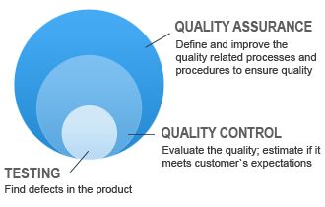
The Software QA Process
QA planning / test planning
Establish test strategy and test plan
What to test, how to test it, when, test scenarios
Test development
Test procedures, test scenarios, test cases, test scripts
Test execution and reporting
Defect tracking

Slide 21
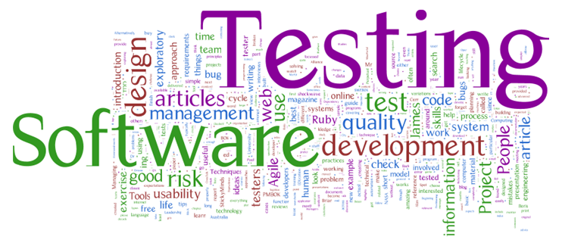
Software Testing
Testing checks whether the developed software conforms to the requirements
Testing aims to find defects (bugs)
Manual and automated testing
Kinds of tests
Black-box and white-box tests
Unit tests, integration tests, system tests, acceptance tests
Stress tests, load tests, regression tests

Slide 22

Test Plan, Test Scenarios and Test Cases
The test plan describes how tests will be performed
List of QA and test activities to be performed to ensure meeting the quality requirements
Features to be tested (scenarios), test cases, testing approach, test schedule, acceptance criteria
Test scenarios and test cases
Test scenarios – stories to be tested
Test cases – tests of single function
Each test scenario is covered by several test cases

Slide 23
Test Scenarios and Test Cases – Example
Sample test scenario:
Test the user registration form
Test cases for this scenario:
Non-existing username → success
Duplicated username → error
Empty username or password → error
Too long username → error
Invalid characters in username / password → error
User Registration
Username:
maria
Password:
•••••••••••
Full Name:
Maria Steward
Register

Slide 24

What Is Testing?

Slide 25
What Is Testing?
The process of exercising software
To verify that it satisfies specified requirements and to detect errors
The process of analyzing a software item
To detect the differences between existing and required conditions (that is, bugs)
To evaluate the features of the software item

Slide 26

What Is Testing?
The process of operating a system or component under specified conditions
Observing or recording the results
Making an evaluation of some aspect of the system or component

Slide 27
Main Test Activities
Testing is not just running tests, but also:
Planning and control
Choosing test conditions
Designing and executing test cases
Checking results
Evaluating exit criteria
Reporting on the testing process and system under test
Finalizing or completing closure activities

Slide 28
Main Test Objectives
Testing pursues several objectives:
Finding defects
Gaining confidence about the level of quality
Providing information for decision-making
Preventing defects

Slide 29
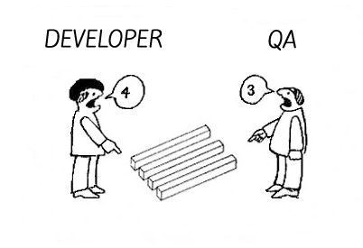
QA vs Devs
QA testers:
Are perceived as destructive - only happy when they are finding faults
Usually require good communication skills, tact & diplomacy
Normally need to be multi-talented (technical, testing, team skills)

Slide 30
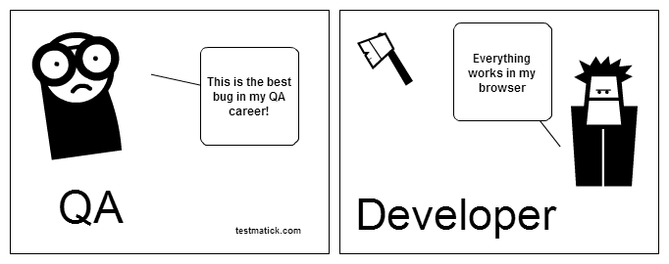
QA vs Devs
Developers:
Are perceived as very creative - they write code without which there would be no system
Are rarely good communicators
Can often specialize in just one or two skills (e.g. Python, JS, Java, SQL)

Slide 31
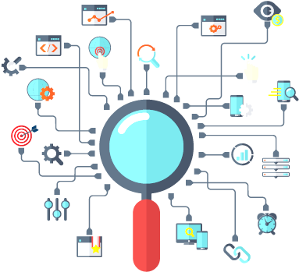
What is QAs’ Job?

Slide 32
Software Requirements Specification
A software requirements specification (SRS)
Description of a software system to be developed, laying out functional and non-functional requirements
May include a set of use cases that describe interactions between the users and the software
Establishes the basic agreement between costumer and contractor
What a software product should do
What it is NOT expected to do

Slide 33
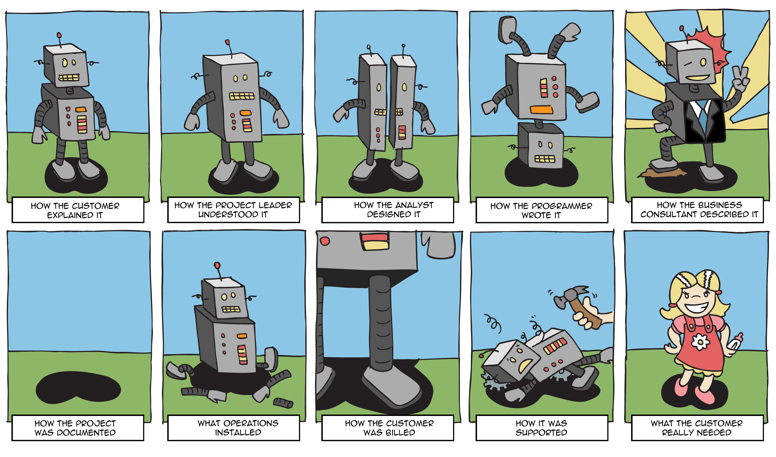
Requirements vs. Solutions

Slide 34
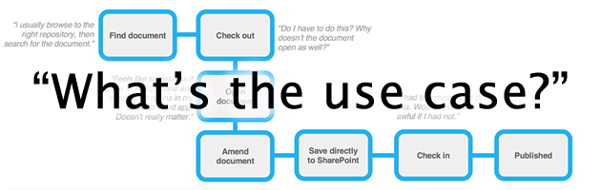
Use Cases
List of interaction steps
Defines relation between an actor and a system
Usually satisfying a goal
Actors are able to take decisions
Decisions lead to subcases

Slide 35

Use Cases
Models
Can be modeled via UML
Can be flat text documents
Template
Name
Actors
Preconditions
Flow
Post conditions

Slide 36
Test Process
Begin
Test Planning and Control
Test Analysis and Design
Test Implementation and Execution
Evaluating Exit Criteria and Reporting
Test Closure Activities
End

Slide 37
Planning of The Resources
Necessary resources:
Which employees are needed, for what, when?
How much time is needed?
Which tools, equipment and utilities?
Necessary training of the employees
Organizational structure
With the appropriate test management

Slide 38
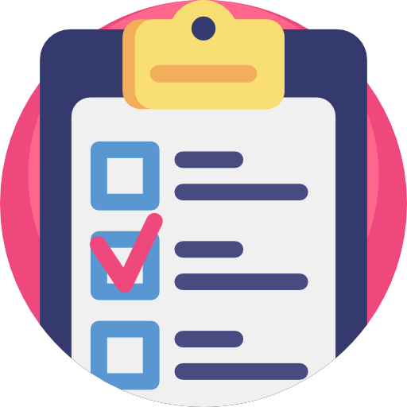
Test Control
Monitoring of the test activities
Comparing with the plan
Reporting status of deviations from the plan
Taking actions for correction
Updating the test plan according to the feedback

Slide 39
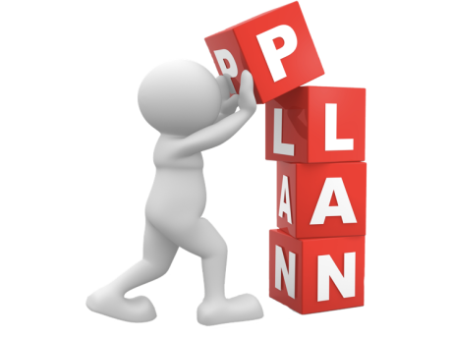
Test Plan
The results from the planning activities should be documented in a test plan
The test plan is a formal document that describes how tests will be performed
List of test activities to be performed to ensure meeting the requirements
Features to be tested, testing approach, schedule, acceptance criteria

Slide 40
Test Analysis And Design
Identify test conditions
Product specification may not be testable
Defining what should be tested starts with reviewing the test basis
Designing test cases

Slide 41
Test Case
Sequence of steps to check the correct behavior
At least two cases to fully test a requirement
A positive test
A negative test
Consist of
Title
Steps to follow
Expected result

Slide 42
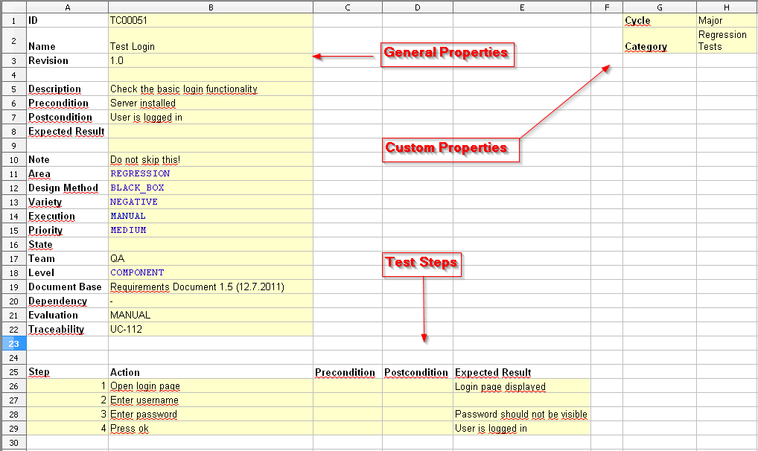
Test Case - Example

Slide 43

Test Case
Optionally may consist of:
ID
Description
Related requirements
Test category
Author
Pass / Fail

Slide 44
Test Execution
How will the tests be executed?
Follows the priority of the test cases set in the test plan
Grouping test cases into test suites
For efficient test execution
For easier overview
Time pressure may cause running just a subset of all tests
Having tests prioritized is important

Slide 45
Reproducibility
The tests must be easily repeated
Test environment
Input data
Test logs
Etc.

Slide 46

Failure Found?
Is it really a failure?
Erroneous or inexact test specification
Problematic test infrastructure or test case
Incorrect test execution
If it is a failure:
The failure must be documented
Rough analysis of possible causes
Additional test cases might be required

Slide 47

Exit Criteria
What is exit criteria?
The set of generic and specific conditions for permitting a process to be officially completed
Agreed upon with the stakeholders
Used to report against and to plan when to stop testing

Slide 48
Exit Criteria - Example
100% statement coverage
100% requirement coverage
All screens / dialogue boxes / error messages seen
100% of test cases have been run
100% of high severity faults fixed

Slide 49
Exit Criteria - Example
80% of low & medium severity faults fixed
Maximum of 50 known faults remain
Maximum of 10 high severity faults predicted
Time has run out
Testing budget is used up

Slide 50
Test Summary Report
The experience gathered should be analyzed and made available for further projects
Achieved results
Unexpected events
What caused them?
Open change requests
Why were they not implemented?
User acceptance after deploying

Slide 51
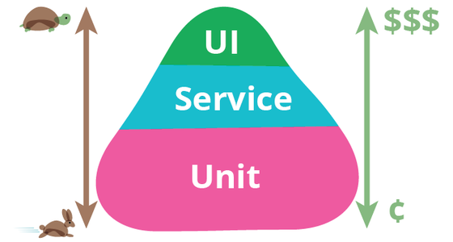
Test Triangle

Slide 52
Static vs. Dynamic Techniques
Static tests
Aim to find problems in the design or concept of the product
Code is NOT being executed
Dynamic tests
Aim to find problems in an instance of the product
Code execution is mandatory

Slide 53
Static Testing Techniques
Static
Static Analysis
Informal Reviews
Control Flow
Data Flow
Inspection
Walkthroughs
Technical Reviews

Slide 54
Dynamic Testing Techniques
Dynamic
Specification-based
Structured-based
Experience-based
Condition
Statement
Decision
Exploratory Testing
Error Guessing
Multiple Condition

Slide 55
Black Box Testing Techniques
Specification-based
Use case testing
Equivalence Partitioning
State Transition
Boundary Value Analysis
Decision Tables

Slide 56
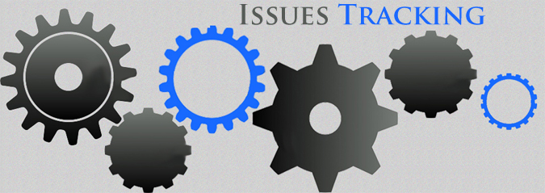
Issue Tracking
Issue Reporting and Tracking, Issue Tracking Tools, Issue Lifecycle

Slide 57
Issue Tracking
QA engineers / testers aim to find bugs (defects)
Once a bug is found, it is recorded and tracked in the defect tracking system (issue tracker) until resolved
Defect lifecycle:
A new defect is recorded in the tracker (status "new")
A developer takes a defect to work on (status "assigned")
A developers fixes a defect (changes its status to "fixed")
The QA verifies a defect is fixed and closes it (status "closed")

Slide 58
Issues – Description
Each issue (bug / defect) holds the following information
Title: Cannot register user "maria"
Description: Registering with user "maria" and password "m1RI@" fails with message "Database connect failed…"
Screenshots: Screenshots of the problem and file attachments
Status: Assigned (assigned to a certain developer for investigation)
Owner: Peter (the developer who currently works on this issue)
Comments: People can discuss and comment the issue
Priority: Critical, High, Average, Low
Example: http://trac.edgewall.org/ticket/2463

Slide 59




Issue Trackers
Many issue tracking systems are available
TRAC – http://trac.edgewall.org
Bugzilla – http://www.bugzilla.org
JIRA – https://www.atlassian.com/software/jira
GitHub Issue Tracker – https://github.com/issues

Slide 60
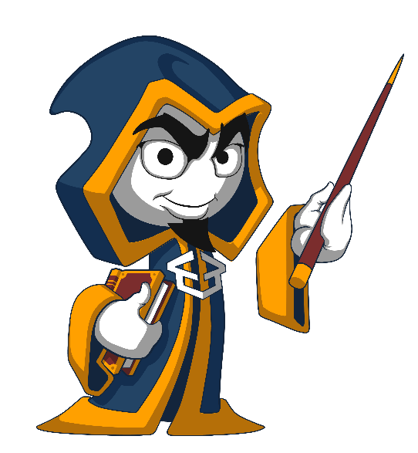
Summary
Software evolved through the time
Retail, web, mobile
It still has bugs
Reasons do not change
Importance of fixing bugs
More customers → more money
No unsatisfied developers
Bug tracking tools and bug reporting
…
…
…

Slide 61

Resources
QA Book: www.istqb.org/downloads/send/2-foundation-level-documents/3-foundation-level-syllabus-2011.html4
Tutorials: www.w3schools.com
Selenium: leanpub.com/selenium-webdriver-book
GitHub: github.com/QualityAssuranceTeam/source

Slide 62
https://softuni.bg/courses/programming-fundamentals

Slide 63












SoftUni Diamond Partners

Slide 64



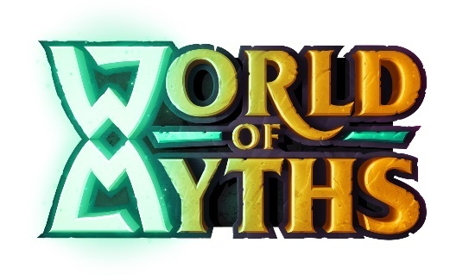
SoftUni Organizational Partners

Slide 65




Trainings @ Software University (SoftUni)
Software University – High-Quality Education and Employment Opportunities
softuni.bg
Software University Foundation
http://softuni.foundation/
Software University @ Facebook
facebook.com/SoftwareUniversity
Software University Forums
forum.softuni.bg

Slide 66

License
This course (slides, examples, demos, videos, homework, etc.) is licensed under the "Creative Commons Attribution-NonCommercial-ShareAlike 4.0 International" license

